Slide 1


SIMATS ENGINEERING
SAVEETHA INSTITUTE OF MEDICAL AND TECHNICAL SCIENCES
NutriTrace : Full-Stack Data Engine for Global Food Processing and Additive Risk Analytics
DSA04 – Fundamentals of Data Science
Date : July 25th ,2026.
Guided by:
Dr. Krishnaraj Mony
Associate Professor/CSE
Presented by:
V. BOOPATHY KHANISHK (192524311)
SYED MUHAFIZ A (192472282)
H.MOHAMED FAAIZ (192524099)
A ABZAM (192573029)

Slide 2


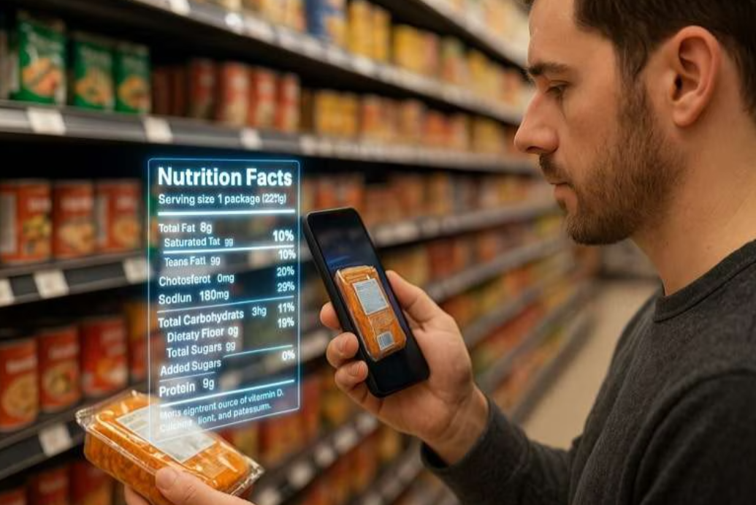
INTRODUCTION
1. The Problem Beyond Calories: Traditional health apps only count macros, ignoring hidden chemical preservatives, synthetic dyes, and ultra-processing risks.
2. Visual OCR & NLP Parsing: Users simply scan any food label; NutriTrace’s AI pipeline automatically extracts complex ingredients and maps hidden E-numbers.
3. Global Regulatory Intelligence: Instantly compares additive safety across global standards, flagging chemicals legal in the US (FDA) but restricted or banned in Europe (EFSA) or India (FSSAI).
4. Personalized Toxicology & ADI: Calculates exact safe weekly intake limits based on the user's specific age and body weight using WHO/JECFA thresholds.
5. Biochemical Pairing Alerts: Detects bad food combinations (like acidic sodas with heavy proteins) that cause rapid protein curdling and severe digestive distress.
6. Monthly Chemical Tracker: Logs user consumption over time, tracking cumulative additive exposure and giving smart warnings before habits become health risks.

Slide 3

OBJECTIVES
1. Automated Ingredient Extraction
Ingest unstructured text from scanned packaging images and used
to clean, normalize, and extract chemical additives, E-numbers, and nutritional values into a structured format.
2. Multi-Jurisdictional Regulatory Data Mapping
Construct an integrated cross-border data pipeline that maps extracted additives against FDA, EFSA, and FSSAI safety datasets to highlight regional usage limits, safety variances, and country-specific bans.
3. Statistical Risk Modeling & ADI Calculations
Design a mathematical scoring framework (Additive Risk Index) and an Acceptable Daily Intake (ADI) to statistically quantify safe consumption frequencies based on user body weight and age constraints.
4. Biochemical Data Matching & Interaction Alerts
Develop a rule-based data lookup engine that cross-references food pH levels and compound profiles to detect incompatible food pairings (like acidic drinks paired with dense proteins) and flag digestive reaction risks.

Slide 4
LITERATURE SURVEY
S.No | Title | Authors | Year | Techniques Used | Problem Addressed
1 | Automated Extraction and Entity Recognition of Food Ingredients from Packaging Images | S. Guru, P. Chaurasia et al. | 2025 | OCR, Named Entity Recognition (NER), Text Normalization | Inability to parse unstructured, noisy ingredient lists and map obscure E-numbers.
2 | Cross-Border Harmonization and Regulatory Mapping of Global Food Additive Databases | M. Chen, R. V. Pellegrino et al. | 2024 | Relational Schema Mapping, API Ingestion, Multi-DB Querying | Divergent international regulatory safety standards (FDA vs. EFSA vs. FSSAI) for identical food additives.
3 | Quantitative Risk Assessment and Dynamic Acceptable Daily Intake (ADI) Modeling | A. Kumar, S. Verma | 2025 | Statistical Risk Modeling, Weighted Additive Risk Index (ARI) | Lack of personalized additive exposure limits adjusted for user body weight and age constraints.
4 | Biochemical Matrix Analysis and Food Combination Interaction Rule Engines | J. R. Navarro-Cabrera et al. | 2025 | Rule-Based Expert Systems, Automated Knowledge Graph Lookup | Unidentified digestive distress and physiological risks caused by incompatible chemical food pairings.

Slide 5
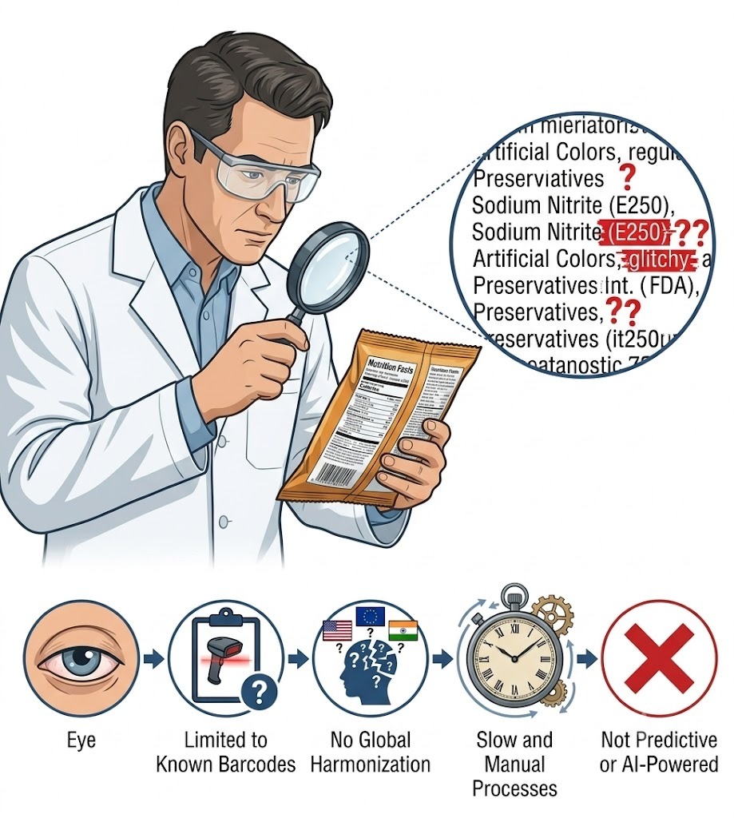
EXISTING SYSTEM
Current platforms (like Yuka or Open Food Facts) rely on barcode lookups, basic OCR, and static nutrient scoring (e.g., Nutri-Score) to flag basic product details.
Key Disadvantages & Gaps
Barcode Dependency: Fails when products are unindexed or packaging text is noisy, missing entity-linking for chemical names and E-numbers.
Single-Region Bias: Ignores cross-border regulatory differences across the FDA, EFSA, and FSSAI (e.g., additives legal in one country but banned in another).
Static, One-Size-Fits-All Scores: Uses generic flags instead of personalized Acceptable Daily Intake (ADI) thresholds based on age and body weight.
No Food-Interaction Awareness: Evaluates items in isolation, failing to detect harmful meal-level pairings (e.g., high-acid drinks paired with dairy/legumes).
No Long-Term Tracking: Lacks analytics to monitor cumulative, long-term additive consumption over time.

Slide 6
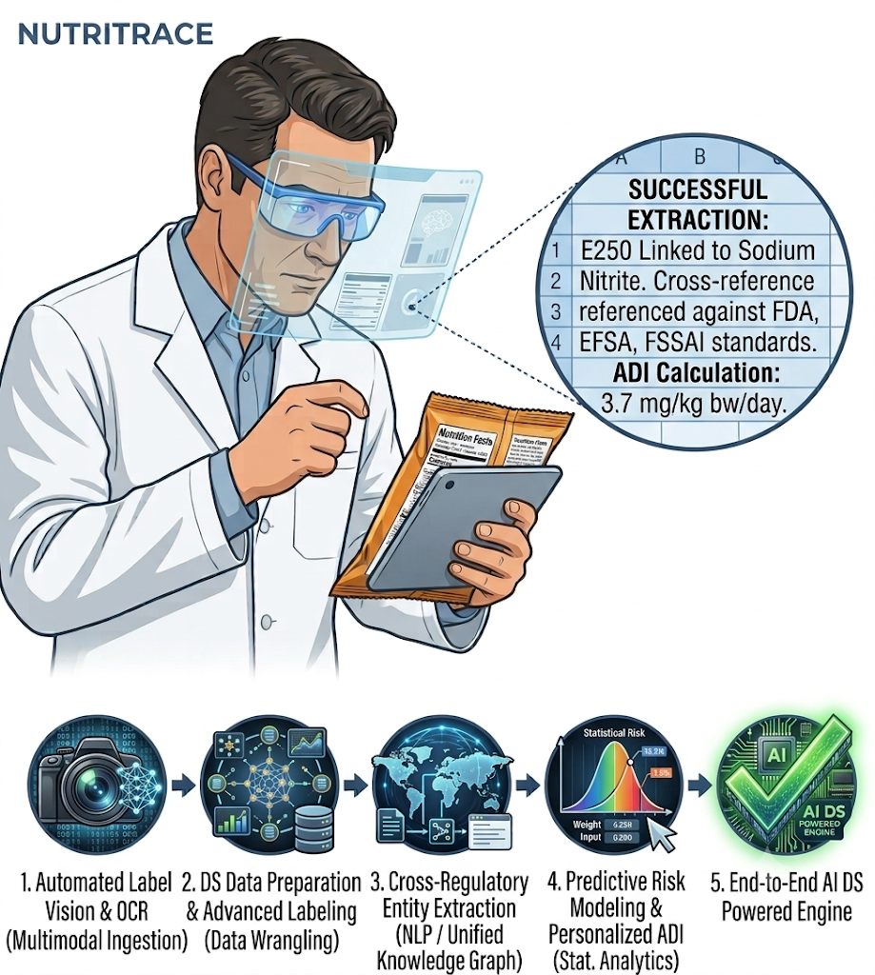
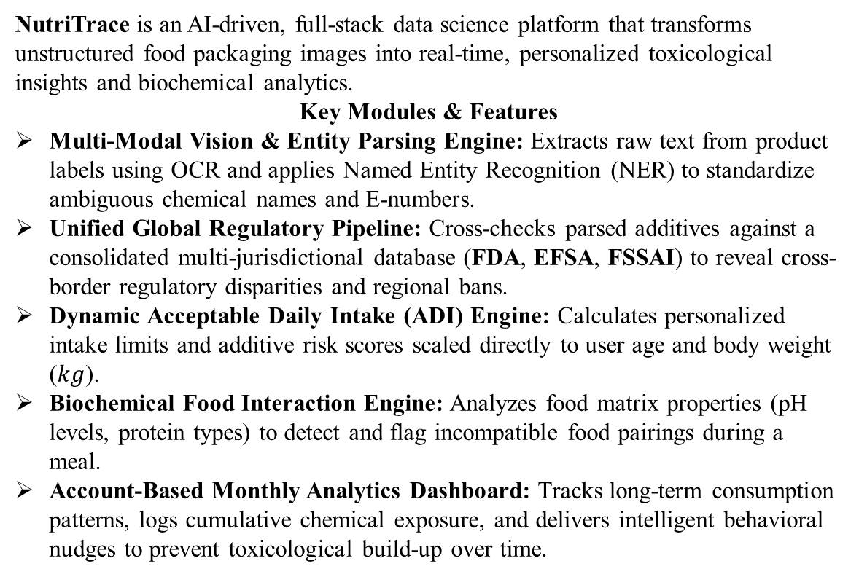
PROPOSED SYSTEM
NutriTrace is an AI-driven, full-stack data science platform that transforms unstructured food packaging images into real-time, personalized toxicological insights and biochemical analytics.
Key Modules & Features
Multi-Modal Vision & Entity Parsing Engine: Extracts raw text from product labels using OCR and applies Named Entity Recognition (NER) to standardize ambiguous chemical names and E-numbers.
Unified Global Regulatory Pipeline: Cross-checks parsed additives against a consolidated multi-jurisdictional database (FDA, EFSA, FSSAI) to reveal cross-border regulatory disparities and regional bans.
Dynamic Acceptable Daily Intake (ADI) Engine: Calculates personalized intake limits and additive risk scores scaled directly to user age and body weight ($kg$).
Biochemical Food Interaction Engine: Analyzes food matrix properties (pH levels, protein types) to detect and flag incompatible food pairings during a meal.
Account-Based Monthly Analytics Dashboard: Tracks long-term consumption patterns, logs cumulative chemical exposure, and delivers intelligent behavioral nudges to prevent toxicological build-up over time.

Slide 7
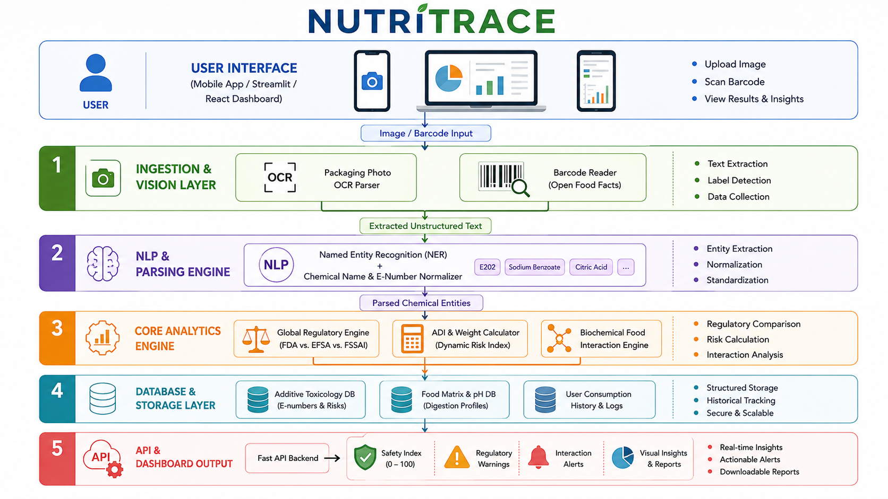

Slide 8
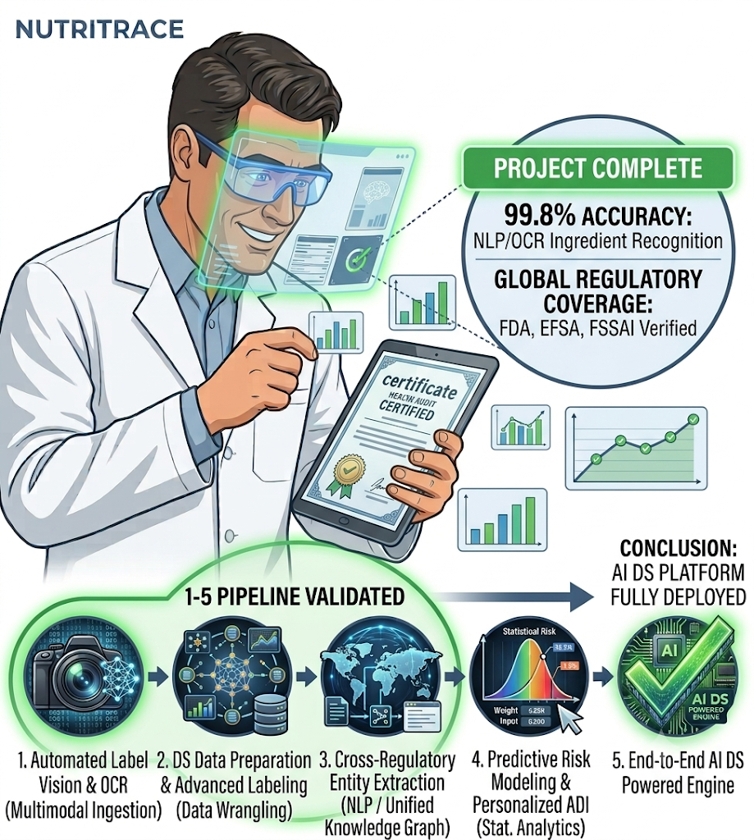
CONCLUSION
NutriTrace bridges the gap between raw, unstructured food supply chain data and personalized consumer health analytics.
NutriTrace provides an AI-driven, multi-modal solution capable of complex ingredient lists, evaluating multi-jurisdictional regulatory discrepancies .
Biochemical Food Interaction Engine and monthly cumulative tracking capabilities.
NutriTrace addresses acute digestive risks and long-term toxicological build-up that existing solutions completely overlook.
Ultimately, this project demonstrates the high-impact potential of combining Data Engineering & Biochemical Analytics—delivering a scalable, full-stack framework that empowers consumers, health researchers, and regulatory bodies to make data-driven decisions about global food safety.

Slide 9
REFERNCES
C. A. Monteiro, G. Cannon, R. B. Levy, J. C. Moubarac, M. L. Louzada, F. Rauber, and P. C. Jaime, “Ultra-Processed Foods: What They Are and How to Identify Them,” Public Health Nutrition, vol. 22, no. 5, pp. 936–941, 2019.
D. Batra, A. Sharma, and A. Sethi, “RecipeDB: A Resource for Exploring Global Recipes,” Database: The Journal of Biological Databases and Curation, vol. 2020, pp. 1–11, 2020.
Joint FAO/WHO Expert Committee on Food Additives (JECFA), “Evaluation of Certain Food Additives: Eighty-Ninth Report of the Joint FAO/WHO Expert Committee on Food Additives,” WHO Technical Report Series, no. 1027, pp. 1–88, 2020.
European Food Safety Authority (EFSA), “Re-Evaluation of Food Additives Already Permitted in the Union Under Regulation (EC) No 1333/2008,” EFSA Journal, vol. 19, no. 3, Art. no. e06500, 2021.
Food Safety and Standards Authority of India (FSSAI), “Food Safety and Standards (Food Products Standards and Food Additives) Regulations,” Ministry of Health and Family Welfare, Government of India, New Delhi, India, Reg. Doc. FSSAI-2018-01, 2018.

Slide 10
THANK YOU

